Slide 1
Queues
Chapter 8
Notes:
1

Slide 2
Chapter Contents
Introduction
Linear (Array) Queue Implementation
Linked Queue Implementation
Queue Implementation: Derived Class
Queue Applications

Slide 3
Objectives
Learn how to implement a queue as an array
Test the array implementation of stacks using the palindrome application

Slide 4
QueueADT (The Queue Abstract Data Type)
QueueADT <Type>
resetQueue( ) : void
isQueueEmpty( ) : boolean
isQueueFull( ) : boolean
enQueue(Type ) : boolean
deQueue(Type ) : boolean
peekAtHead(Type ) : boolean
getQueueSize( integer ) : void

Slide 5
Queue Implementation
Linear Implementation (as an array Queue)
Linked Implementation (as a linked Queue)
Derived Class Implementations
Using public Inheritance
Using private Inheritance
Using Composition

Slide 6
Implementation of Queues as Arrays
Array to store queue elements
Variable queueFront index of the first queue element
Initially queueFront = -1
Variable queueRear index of the last queue element
Initially queueRear = -1
Variable maxQueueSize

Slide 7
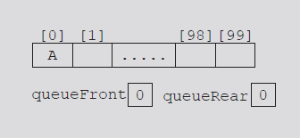
Implementation of Queues as Arrays
Using queueFront, queueRear to access queue elements
queueRear changes after each enQueue operation

Slide 8
Implementation of Queues as Arrays
Using queueFront, queueRear to access queue elements
queueRear changes after each enQueue operation

Slide 9
Implementation of Queues as Arrays
Using queueFront, queueRear to access queue elements
queueFront changes after each deQueue operation

Slide 10
Implementation of Stacks as Arrays
What happens after executing several enQueue and deQueue operations?
Eventually index queueRear points to last array position
Looks like a full queue
Reality: queue has two or three elements, array empty in the front

Slide 11
Implementation of Stacks as Arrays
First solution: Upon queue overflow to the rear
Check value of queueFront
If there is room in front, slide all queue elements toward first array position
Efficient if queue size is very small!

Slide 12
Implementation of Stacks as Circular Arrays
Second solution: assume circular array
queueRear = (queueRear + 1) % maxQueueSize;
queueFront = (queueFront + 1) % maxQueueSize;

Slide 13
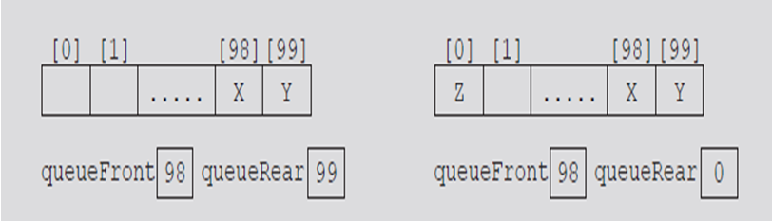
Implementation of Stacks as Circular Arrays
Advances queueRear (queueFront) to next array position

Slide 14

Implementation of Stacks as Circular Arrays: Test Case 1
Queue before executing a deQueue operation:

Slide 15

Implementation of Stacks as Circular Arrays: Test Case 1
Now, execute the deQueue operation

Slide 16

Implementation of Stacks as Circular Arrays: Test Case 2
Queue before executing a enQueue operation:

Slide 17

Implementation of Stacks as Circular Arrays: Test Case 2
Now, execute the enQueue operation

Slide 18

Implementation of Stacks as Circular Arrays: Test Cases
Is the queue full or empty?
Do not rely on comparing queueFront and queueRear to decide whether the queue is empty or full!

Slide 19
The ArrayQueue Class
ArrayQueue <Type>
*queue : Type
maxQueueSize : int
queueFront: int
queueRear: int
ArrayQueue( int = 100 )
resetQueue( ) : void
isQueueEmpty( ) : boolean
isQueueFull( ) : boolean
enQueue(Type ) : boolean
peekAtFront(Type ) : boolean
deQueue(Type ) : boolean
getQueueSize( integer ) : void
getQueueMaxSize( integer ) : void
printQueue( ) : void
~ArrayQueue()

Slide 20
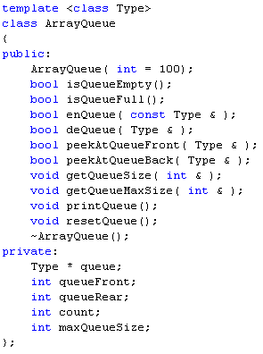
Implementing The ArrayQueue Class

Slide 21
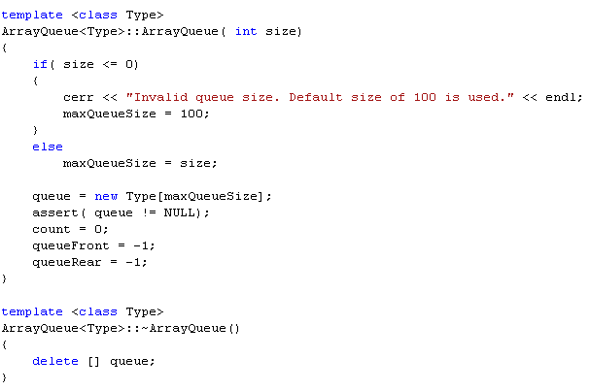
Implementing Constructor & Destructor

Slide 22
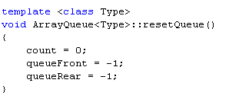
Resetting a Queue
Reset queueFront to -1,queueRear to -1, and count to 0 to re-initialize the queue

Slide 23

Empty Queue
Value of count indicates if queue is empty
If count is equal to zero: queue empty
Otherwise: queue not empty

Slide 24
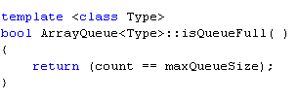
Full Queue
Value of count indicates if queue is full
If count is equal to maxQueueSize: queue full
Otherwise: queue not full

Slide 25
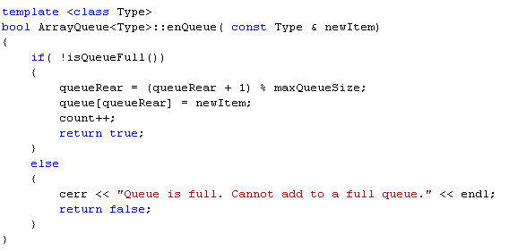
Implementing the enQueue Operation
Increment queueRear (Note implementation of circular array)
Store newItem in array component indicated by queueRear
Increment count

Slide 26
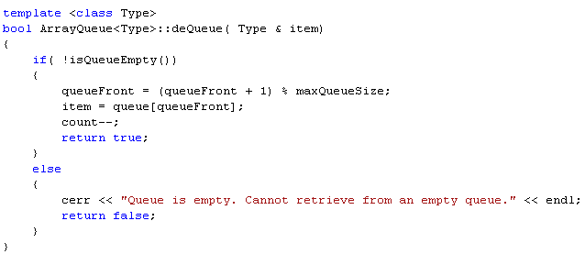
Implementing the deQueue Operation
Increment queueFront (Note implementation of circular array)
Retrieve array component indicated by queueFront into item
Decrement count

Slide 27
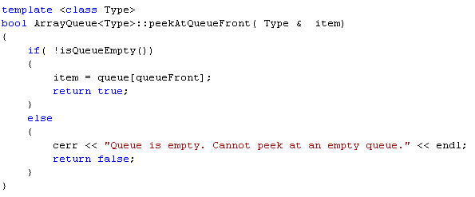
Implementing the peekAtQueueFront Operation
Similar to the deQueue operation but we do NOT decrement count
Retrieve array component indicated by queueFront into item

Slide 28
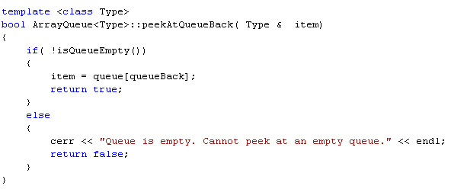
Implementing the peekAtQueueBack Operation
Similar to the deQueue operation but we do NOT decrement count
Retrieve array component indicated by queueBack into item

Slide 29
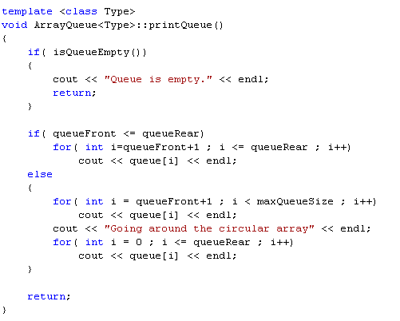
Displaying Contents of the Queue

Slide 30
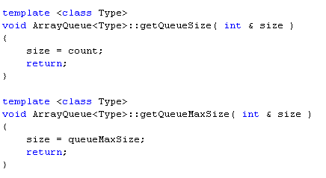
Utility Functions: Queue Sizes

Slide 31
Circular Queue Implementation: Summary
An array holds the queue elements
Two indices are used to indicate both ends of the queue
A set of queue operations
Advantage:
Elegant
Disadvantage:
Not very efficient
Wasteful of space when multiple queues are to coexist (separate arrays for separate queues)

Slide 32
Section 2 - End

